Slide 1

KS2 Writing Workshop for Parents
South Avenue Primary School
November 7th 2023

Slide 2
Workshop Aims…
To review the National Curriculum expectations for English at KS2
To share the English intent at South Avenue
To explore what we currently do in school to support your child’s progress in writing
To provide information on how you can help at home
To eat biscuits and drink tea

Slide 3
The National Curriculum
The national curriculum for English aims to ensure that all pupils:
read easily, fluently and with good understanding
develop the habit of reading widely and often, for both pleasure and information
acquire a wide vocabulary, an understanding of grammar and knowledge of linguistic conventions for reading, writing and spoken language
appreciate our rich and varied literary heritage
write clearly, accurately and coherently, adapting their language and style in and for a range of contexts, purposes and audiences
use discussion in order to learn; they should be able to elaborate and explain clearly their understanding and ideas
are competent in the arts of speaking and listening, making formal presentations, demonstrating to others and participating in debate.

Slide 4
Writing Intent at South Avenue
South Avenue Primary School believes that writing is a key skill for life both inside and out of education and that is why it features across all the subjects taught across our school.
Our aim is to provide children with transferrable writing skills to build on year-on-year, that can be used throughout each phase of their education, and prepare them for secondary school.
Teaching children to write for a range of purposes and audiences can be very exciting, especially here at South Avenue where we provide children with a range of engaging hooks to capture their imagination. We aim to provide the children with varied reasons for writing and believe that this not only produces higher quality writing, but allows our learners to apply their skills in a range of different contexts.
Writing across all subject areas will prepare our children for secondary education and a more in-depth approach to analysing, planning and innovating their writing.
We recognise the importance of nurturing a culture where children take pride in their writing, can write clearly and accurately and adapt their language and style for a range of contexts.
Our aim is for ALL learners to achieve their full potential in writing and we are committed to providing the scaffolds and challenge needed in order for our children to achieve this whilst fostering a love of writing.
At South Avenue, we are excited about writing!
Notes:
Hooks – year 1 learning about bonfires and started by making an actual fire in the school grounds
Year 3 – find a hidden dragon egg
Year 6 – turn the lights out bring in torches, hide in pretend Anderson shelters to experience what it was like to be a child in ww2

Slide 5
How is our writing taught in KS2?
Your children are taught writing throughout the school week not just in English lessons but also across all subjects.
This includes:
A daily writing lesson (45-60 minutes)
A daily spelling session (15 minutes)
Up to 3 handwriting sessions weekly depending on year group (15 minutes)

Slide 6
Handwriting at South Avenue
For some it is purely an art form, and the neatness and accuracy of the presentation is the main focus. For others, it needs to be a functional tool which allows them to put ideas on paper, effortlessly and fast.
Handwriting is a means of communicating to others. It can be very personal, a part of our self-image and an expression of our own personality.
Handwriting might be some or all of these things.

Slide 7
Progression in Handwriting (KS2)
Year 3- form and use all 4 basic handwriting joins
- Write legibly
Year 4- as above and…
- Write with consistency in size
- Ensure that down strokes of letters are parallel and equal
Ensure that writing is sufficiently spaced
Year 5- as above and…
Write fluently with a joined style
Write at speed
Choose when it is appropriate to join or print
Year 6- as above and…
Write with increasing speed
Choose the writing implement that is best suited for a task
Notes:
The NC says that to be expected at the end of KS2 year 6, children must be able to write in a ‘cursive’ joined, legible style

Slide 8
Progression
4 basic joins :
Diagonal joins to letters without ascenders
e.g ai, ar, un
Horizontal joins to letters without ascenders
e.g. ou, vi, wi
Diagonal joins to letters with ascenders
e.g. ab, ul, it
Horizontal joins to letters with ascenders
e.g. ol, wh, ot
Notes:
Hand out Twinkl handwriting style sheet with practice

Slide 9
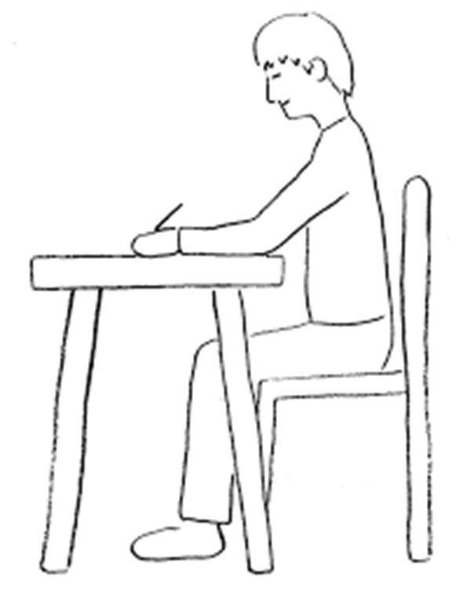
A Typical Handwriting Session
1. Posture
2. Warm up
3. Practise a particular join- Horizontal joins to letters with ascenders- wh
4. Apply the join into a word
Notes:
Have a go on the paper

Slide 10
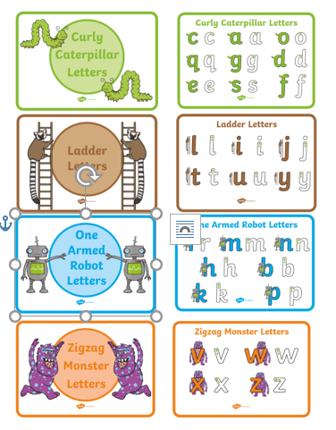
Twinkl Handwriting
Letter Families

Slide 11
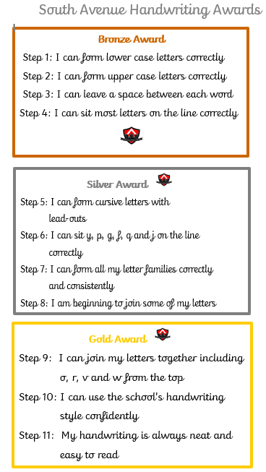
Notes:
All children work towards their pen licence and this is awarded when they can write in a cursive, legible style – consistently orientating their letters on the lines, finger spaces, consistent size and formation of letter – pens can then be used in all books apart from maths and not for crossing out
Licences like driving licences if standard not kept up they can be withdrawn
To keep children motivated, we award bronze, silver and gold awards as they sow progression in their handwriting – these are awarded by the class teachers and stuck in their English books

Slide 12
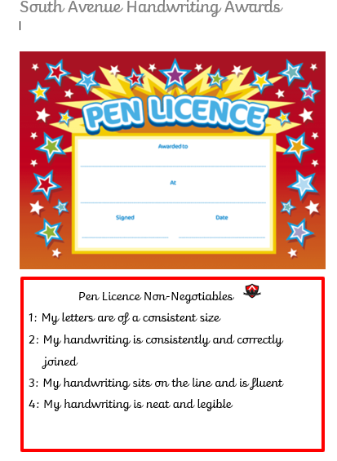
Notes:
These are awarded by a member of the writing team and sent home

Slide 13
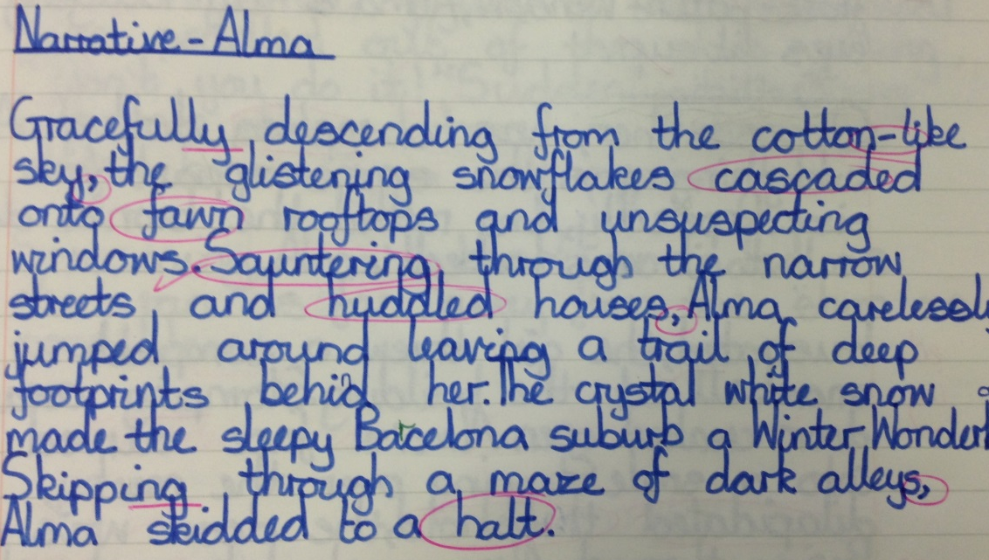
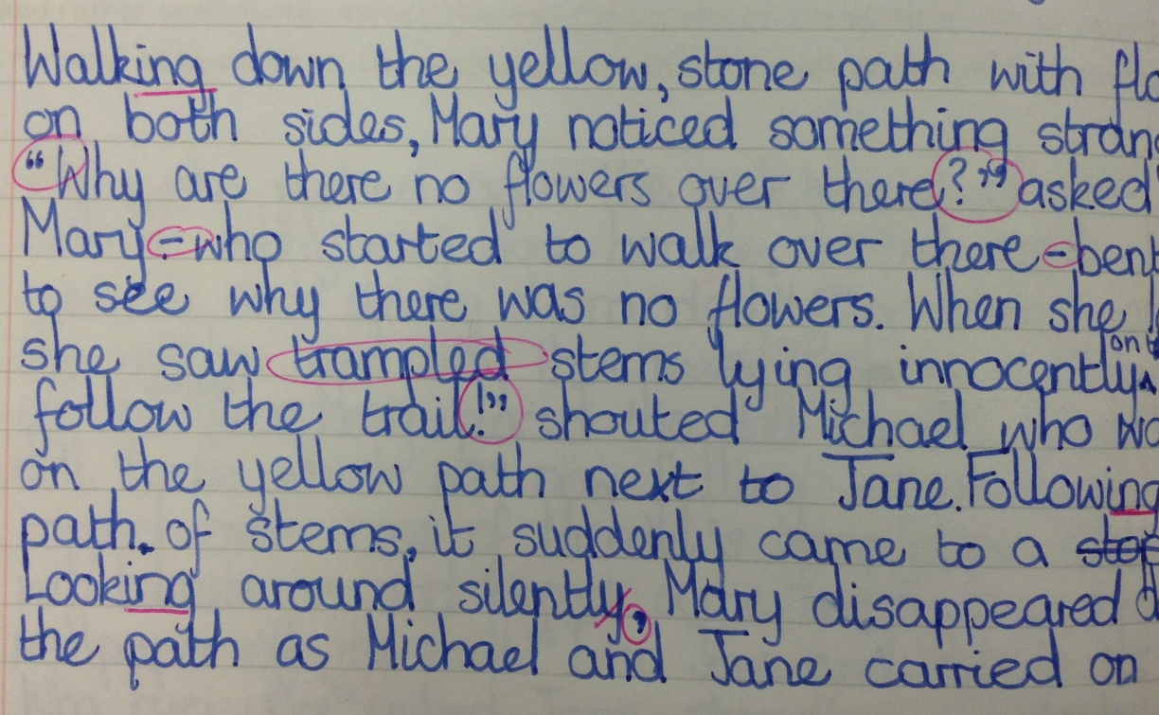
Examples

Slide 14
How can you help with handwriting?
Place importance on handwriting whenever children are writing- not just in their school books
Encourage good posture when they are writing
Ensure they are using a sharp pencil or suitable pen
Most importantly, praise and promote- it will not change overnight!

Slide 15
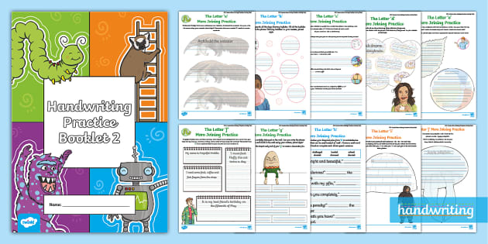
Please do take any of the booklets your child to complete at home.

Slide 16
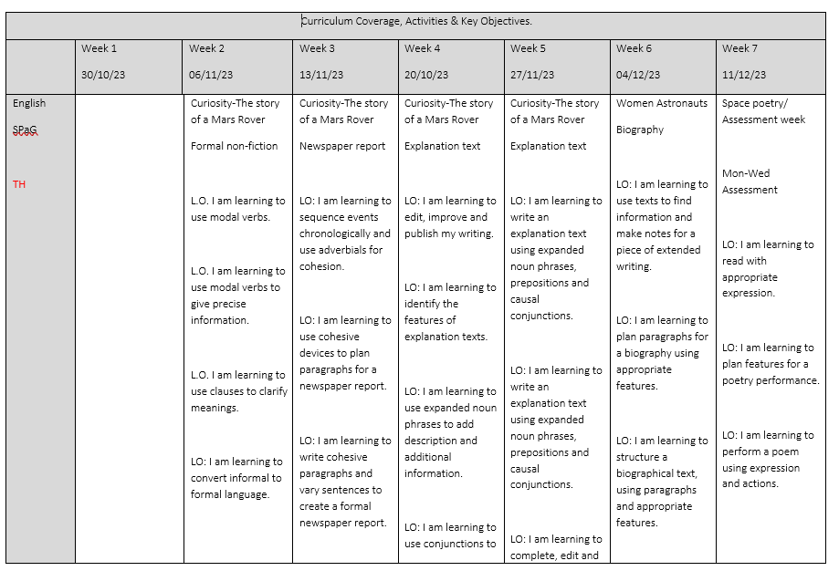
English Writing Lessons
Our English lessons at South Avenue focus on a variety of texts and genres from fiction, non-fiction and poetry.

Slide 17
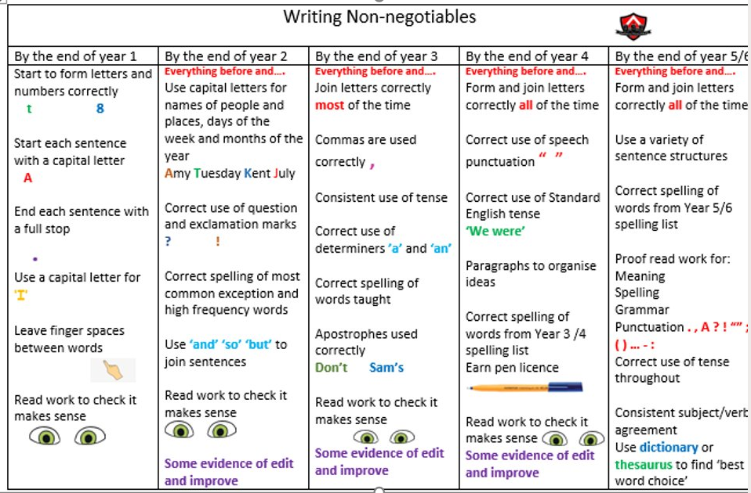

Slide 18
Teaching Sequence
Inspirational hook – chosen text/genre
Look at and annotate examples of ‘a good one’
Teach the skills needed to write their own independently
Write independently
Edit and improve
Publish – published pieces are stuck in their writing journals and these are taken through to year 6

Slide 19
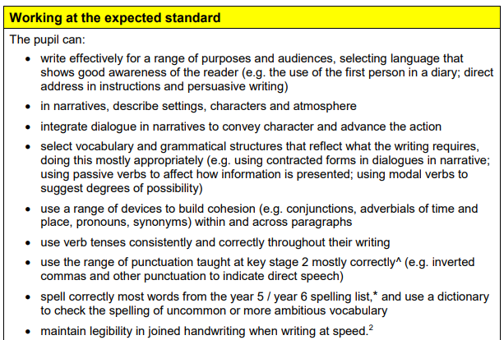
What should they have achieved by the end of KS2?

Slide 20

Sharing Examples of Year Group Expectations
On your tables are a selection of children’s writing for years 3-6
These children are assessed as meeting the expected standard in writing for their year group
Do have a look !!
Notes:
Put out a selection of English books and writing journals allow time to look through

Slide 21
How can you help?
Your children will learn about writing by watching you write. Talk with them about your writing so that they begin to understand why writing is important and the many ways it can be used
Give your child opportunities to practice writing by helping them sign birthday cards, write stories, and make lists
Encourage the use of high level vocabulary and up-levelling sentence work during homework tasks
Do some short writing pieces linked to the book they are reading
Ask about new words they have learnt in school – have they learnt any new words today?
Write in diaries any interesting words which could be used in class – where appropriate, these can be discussed

Slide 22
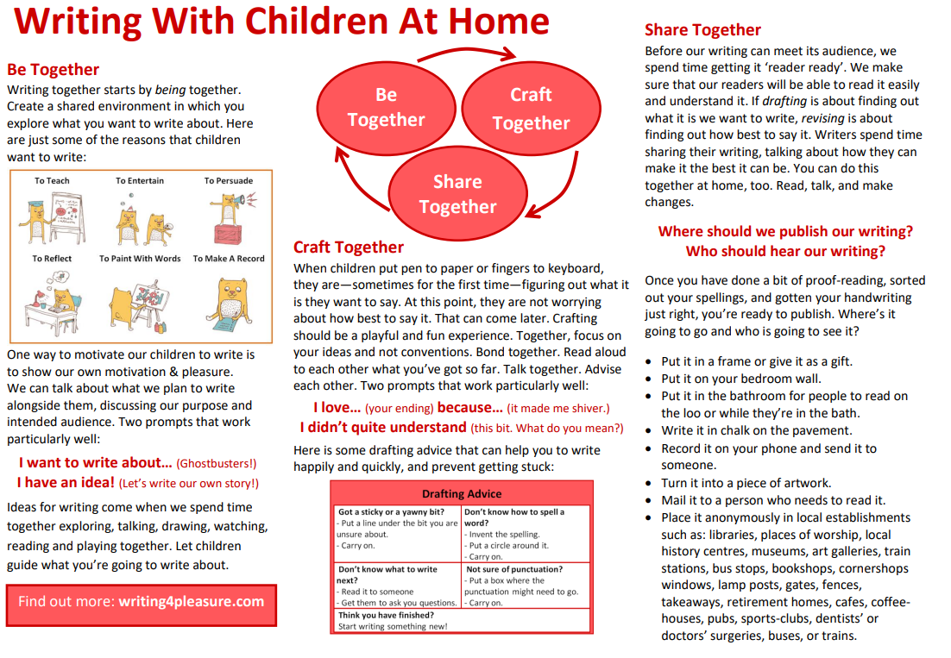

Slide 23
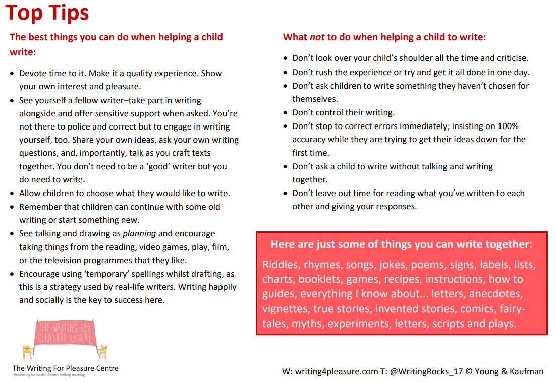

Slide 24
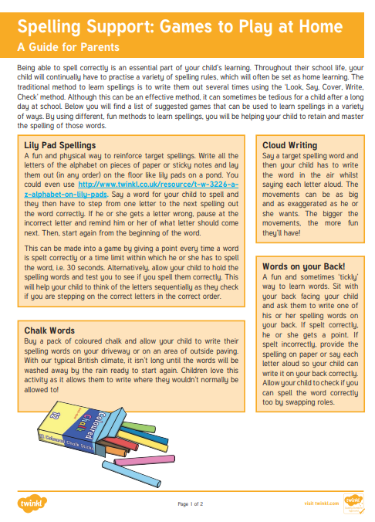
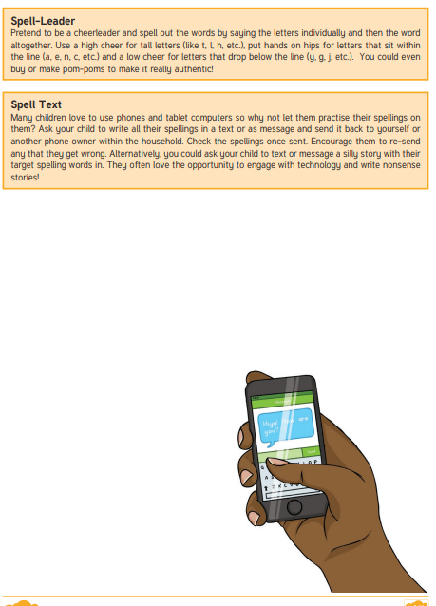
Spelling
Notes:
Handout spelling games to play at home

Slide 25
Learning to spell is a highly complex skill but in order for children to become successful writers they need to be able to spell accurately. At South Avenue Primary School your child will learn the rules and conventions of the spelling system as well as strategies needed to become confident spellers. In Reception, Year 1 and Year 2 the children have daily phonic lessons where they learn phonemes and graphemes, spelling patterns and high frequency words. In Years 3, 4, 5 and 6 the children learn a new spelling pattern every week as well as revising those already taught. Spelling is taught at least three times a week where children look at spelling rules, root words, meanings of words and other strategies to help spellings such as mnemonics. Teachers provide opportunities throughout the week for the children to practise and apply these rules. In addition to this, teachers model good spelling practice through their daily teaching, across all subjects.
It is important that children are able to apply the rules taught to spell other words, therefore, spelling is sometimes assessed through dictations where the teacher gives children words to spell that contain the same spelling pattern or rule but are different to the words learnt for the assessment. Learning to spell is most effective when it is done in an enjoyable and interesting way.
Notes:
Phoneme – sounds
Graphemes – symbol/s representing the sounds

Slide 26
Finally…
As always, we have an open door policy at school – please let us know if you have any queries or concerns about their writing
Thanks for coming! ☺
Any questions?

